Slide 1
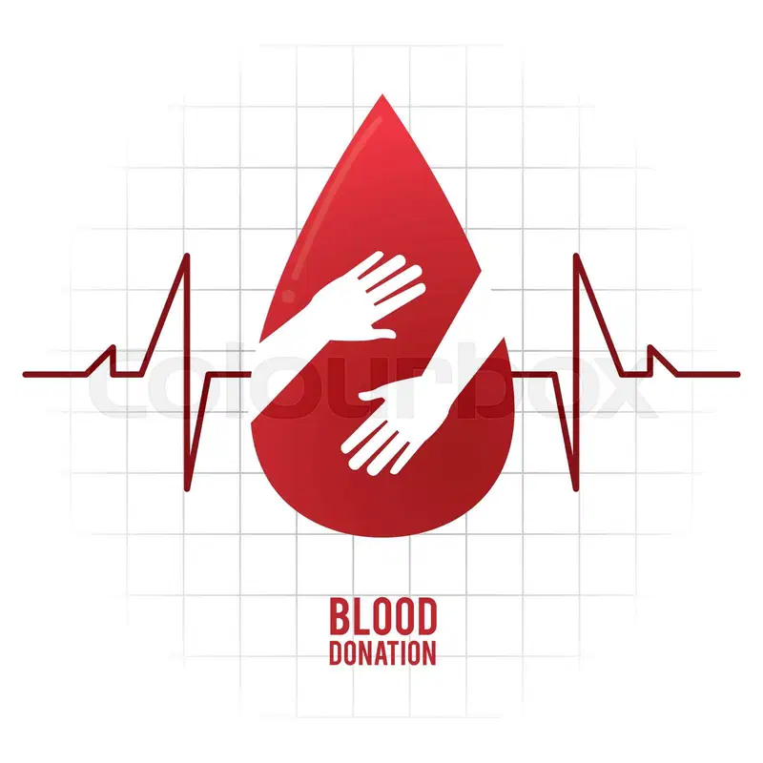
“Save”
-Your Medical Companion

Slide 2

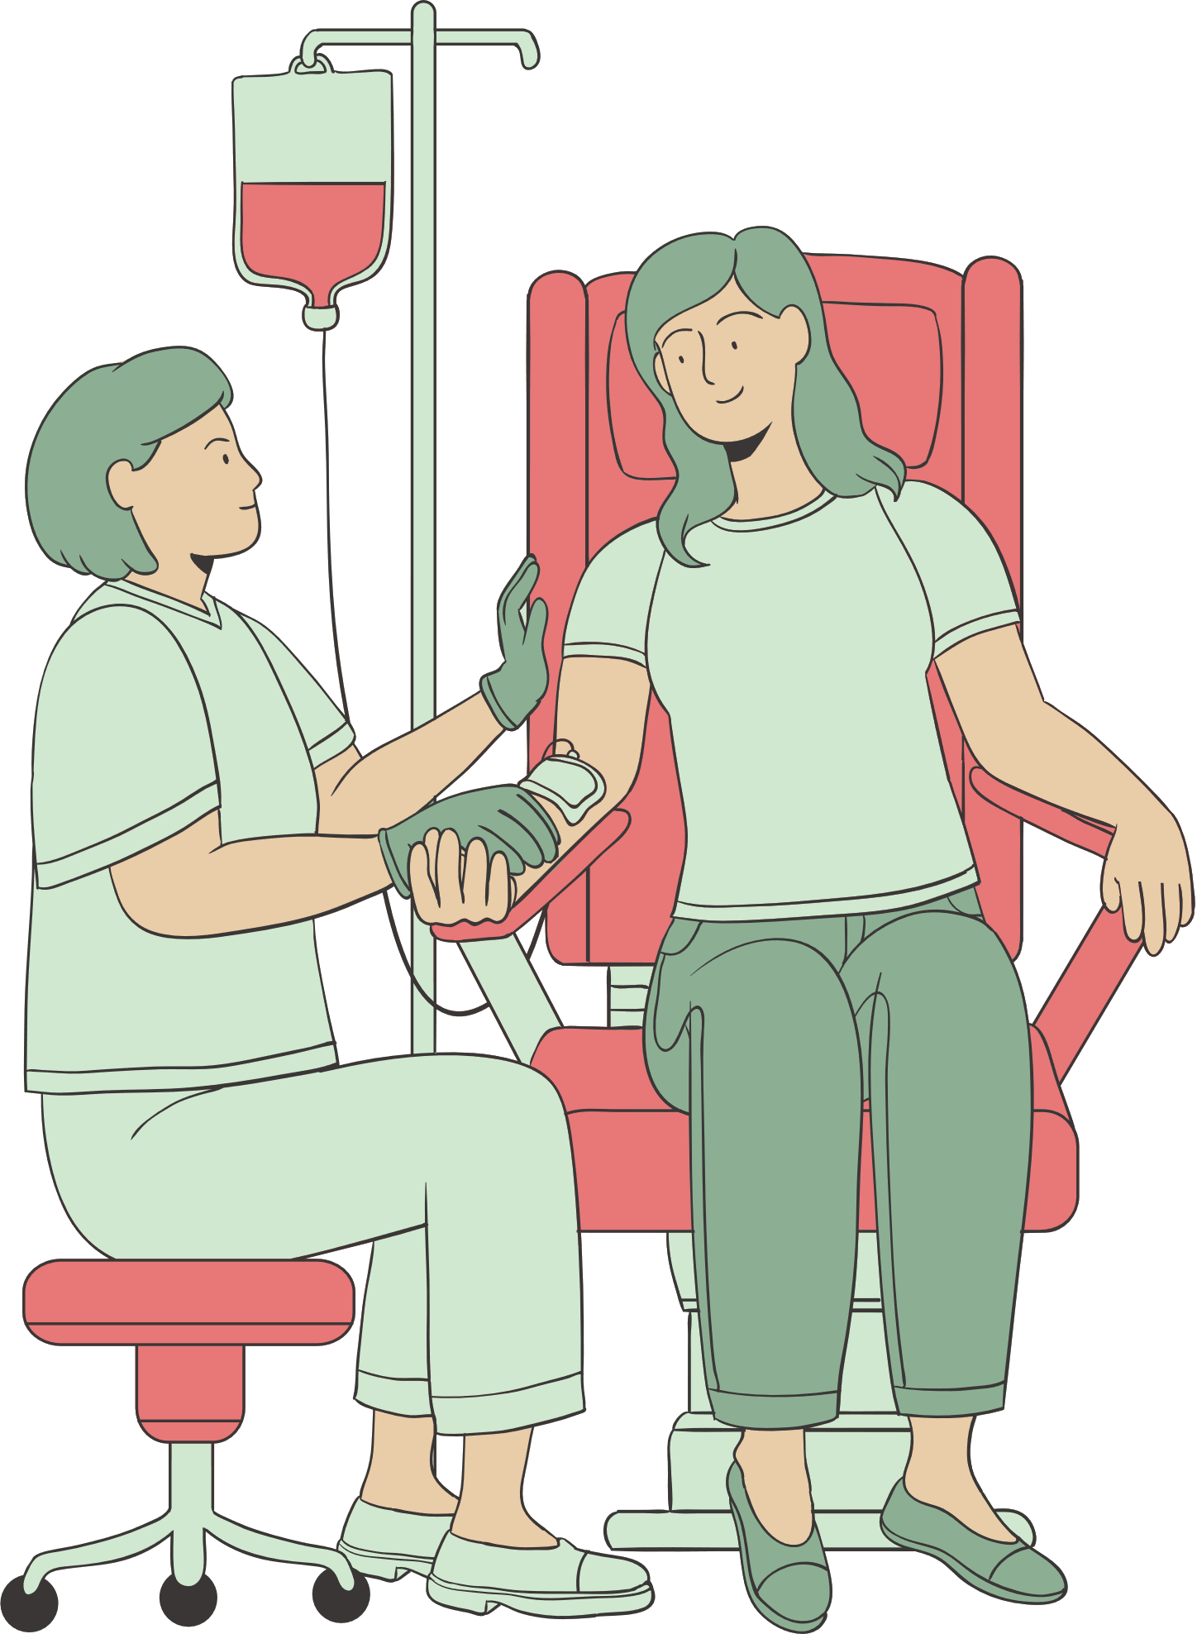
INTRODUCTION
01
Sometimes, there is a need for a specific medicine or a specific blood type in an urgent and urgent manner, but there is a shortage and shortage of medicines in pharmacies and blood types in blood centers and hospitals.
This is where the idea came from: -
The idea of ​​the project revolves around the shortage of medicines in pharmacies and blood bags in blood centers and hospitals and attempts to limit and collect the places where they are located so that the patient can easily access them.

Slide 3
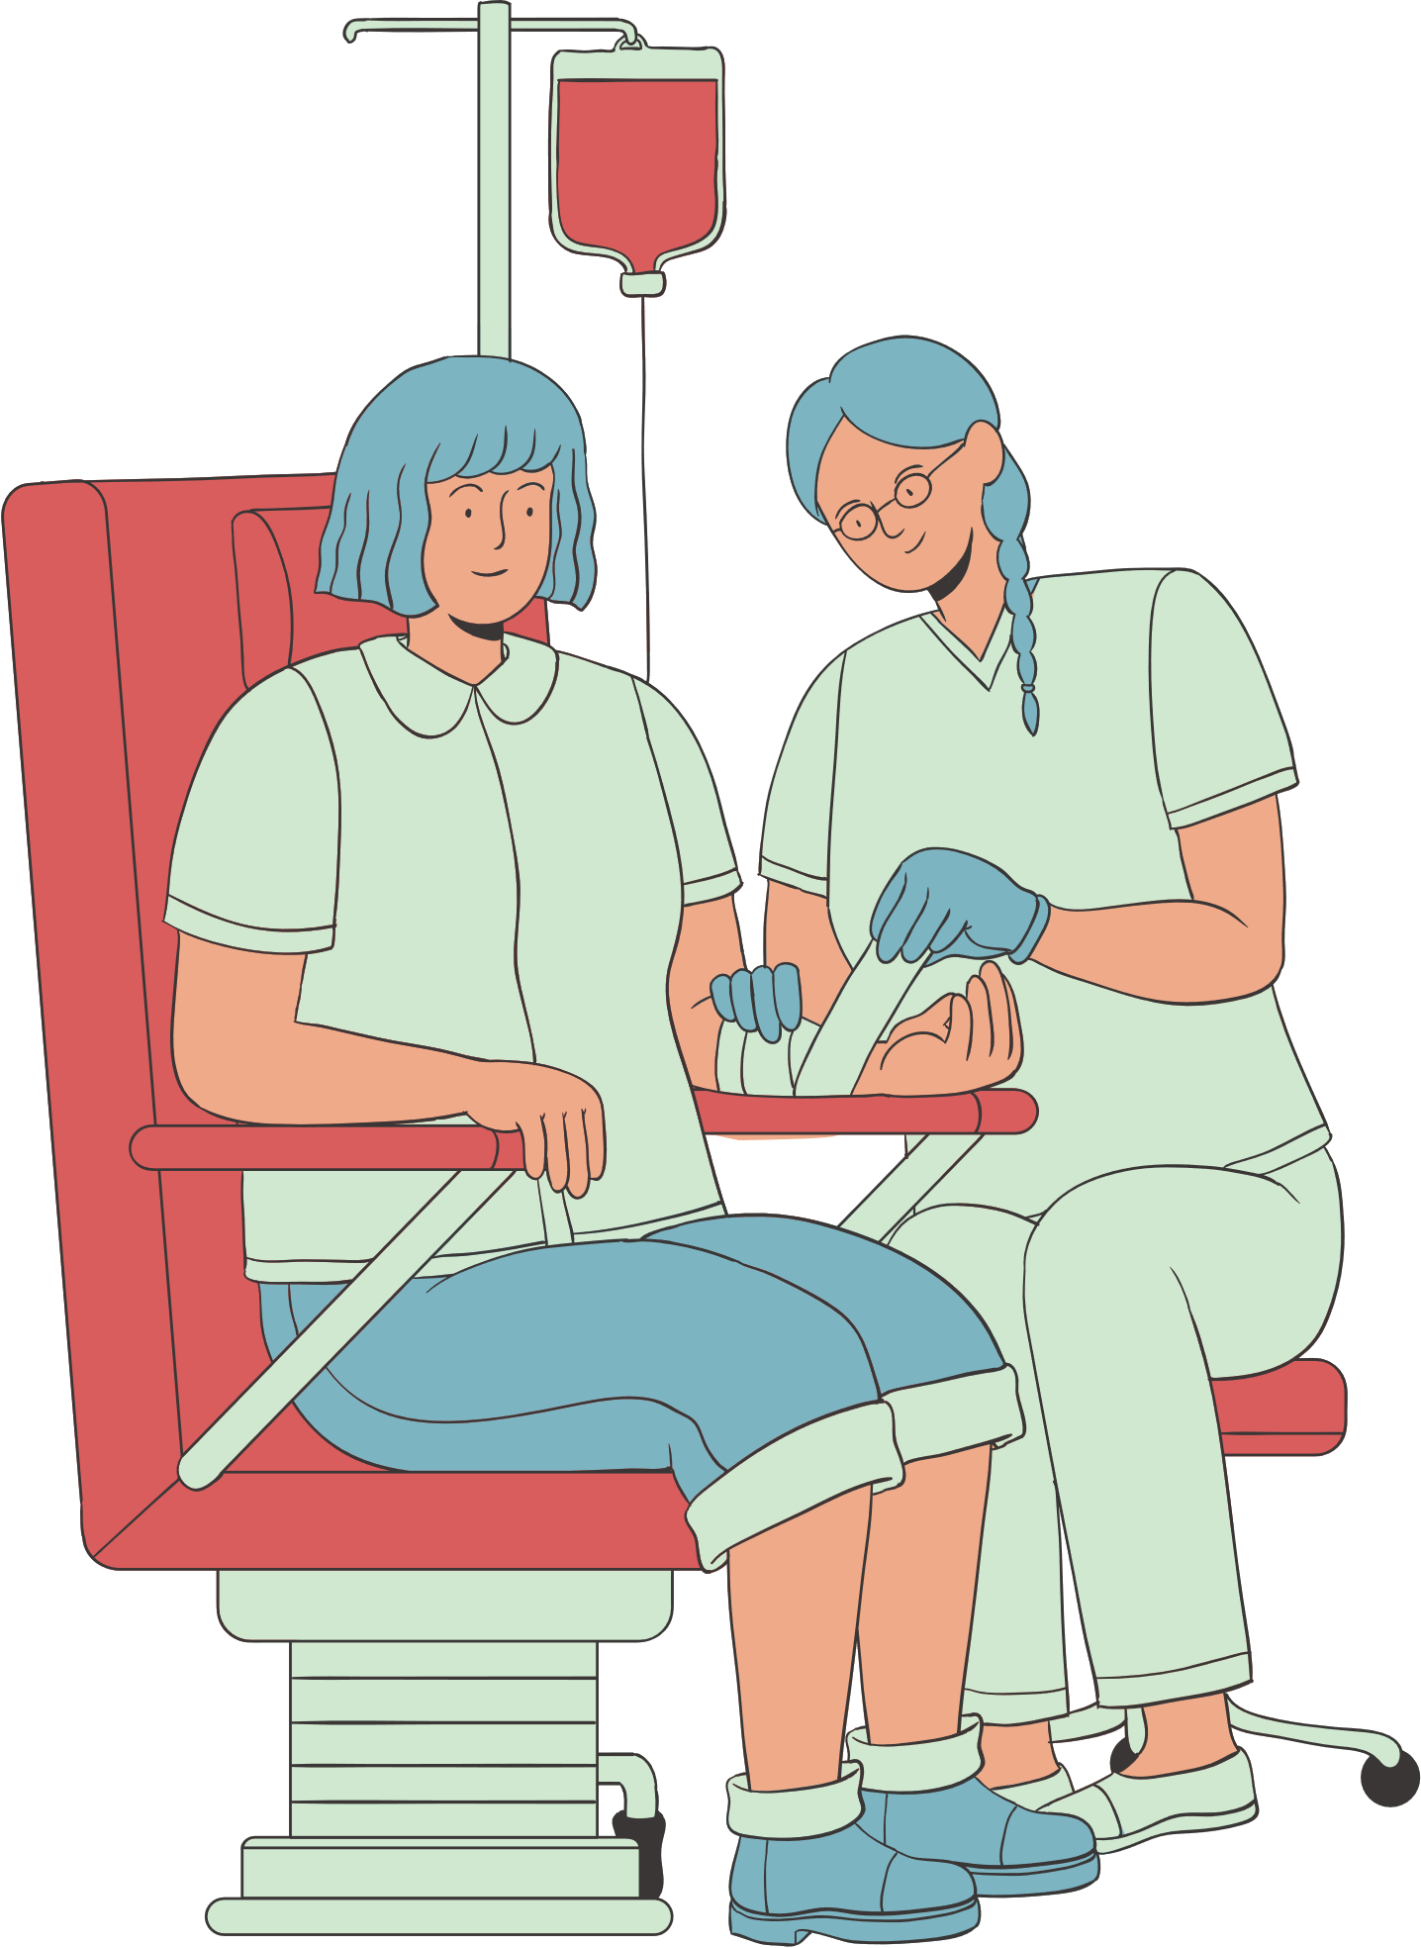
Project Features
It is an application on smart phones that contains a collection of data related to the availability of medicines, especially those that are in short supply in pharmacies, as well as blood bags of different types that are also in short supply,
so that it collects and displays their locations in pharmacies, centers and hospitals near the application user.

Slide 4
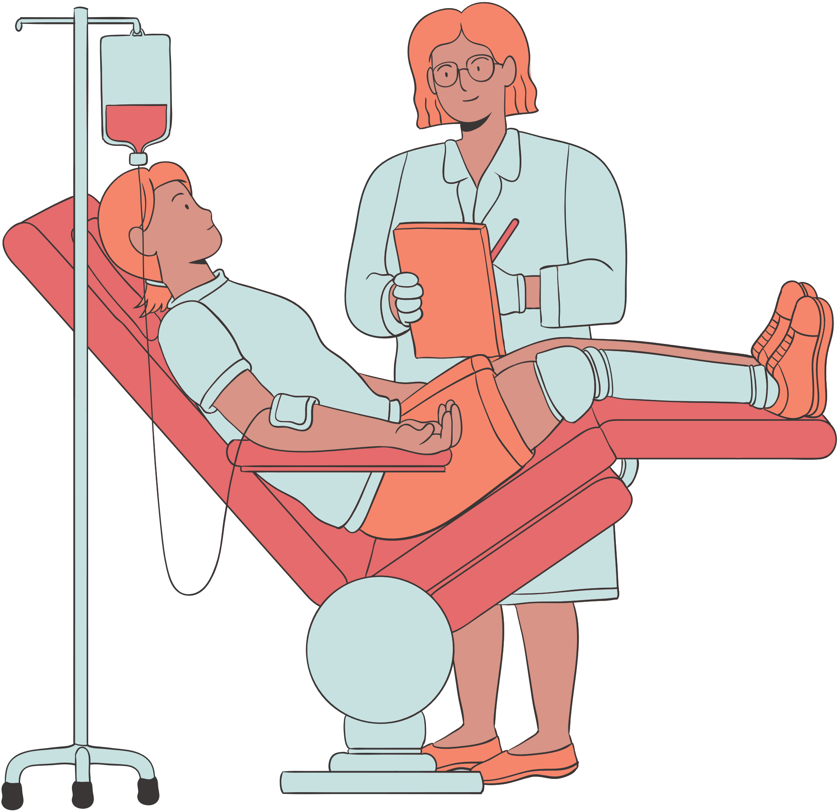
Needs and problems
The need for the availability of blood in hospitals and blood centers, especially the different blood types, with easy access to them.
Ease of providing locations for the different blood types in health authorities.
The need for a rapid response to access medicine and blood.
Reducing their trade in the black market.
The need for the existence of safe and reliable sources to provide blood and medicine.

Slide 5
Objectives
Contribute to reducing the number of deaths
2. Reduce health risks
3. Increase the response rate to drug requests
4. Raise the level of productive performance
5. Reduce problems resulting from selling on the black market and corruption issues within two years in cooperation with regulatory authorities

Slide 6


Slide 7
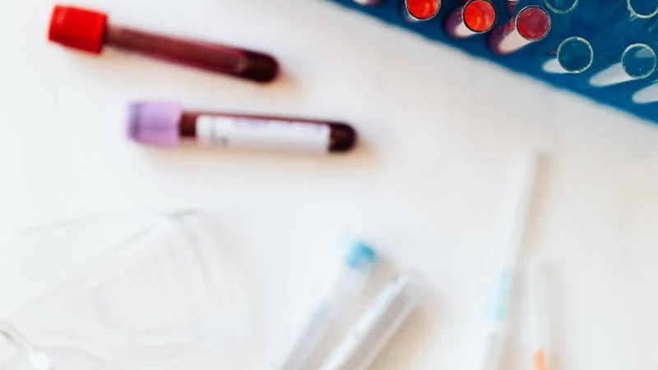
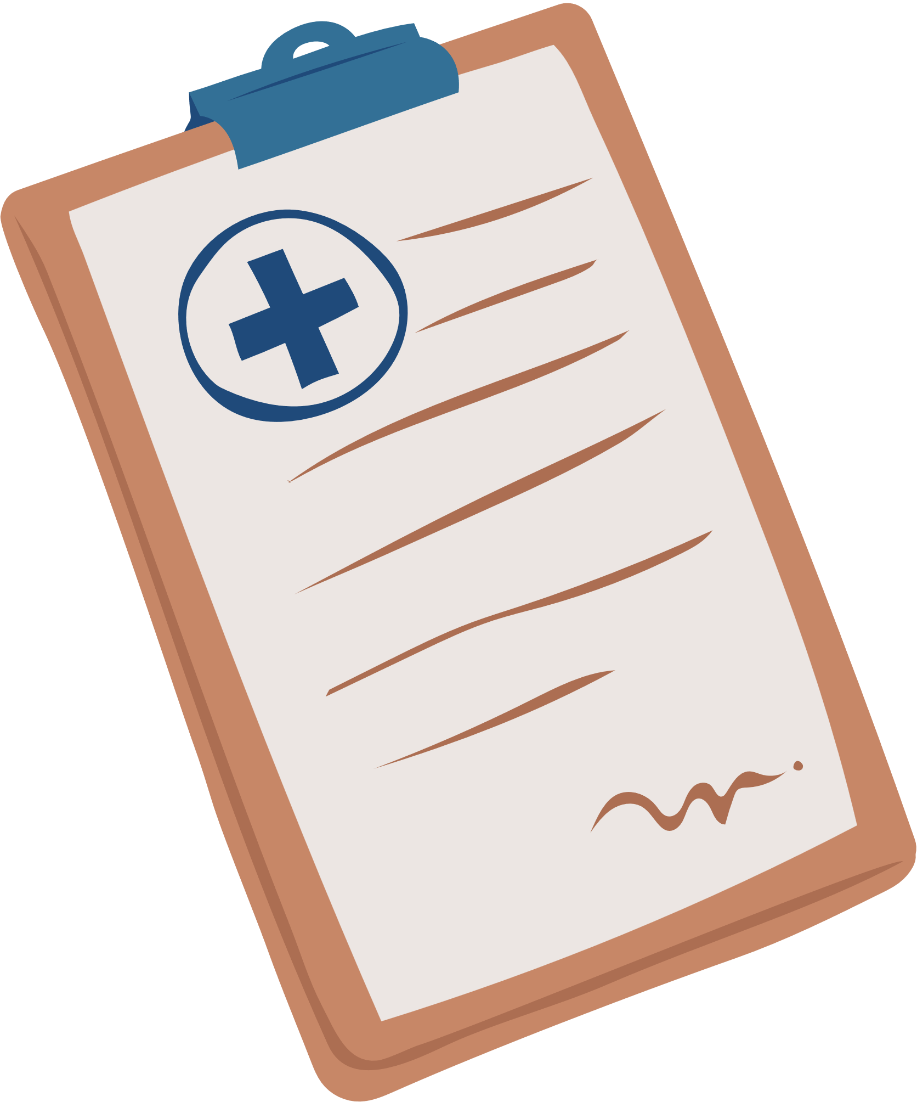
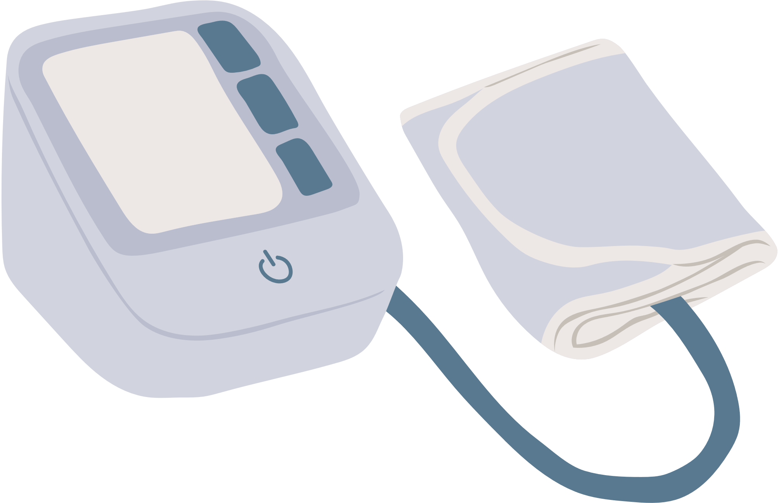
what’s new
Collecting and Using Data:
Our app collects real-time data from blood donors, blood banks, and pharmacies.
It uses location data to help people find the nearest blood banks or medicines.
01
02
03
2. Using predictive Models:
Predict when and where blood might be needed to avoid shortages.
Suggest the best times for donors to donate blood based on health and availability.
Predict which medicines might run out in pharmacies so they can restock in time.

Slide 8
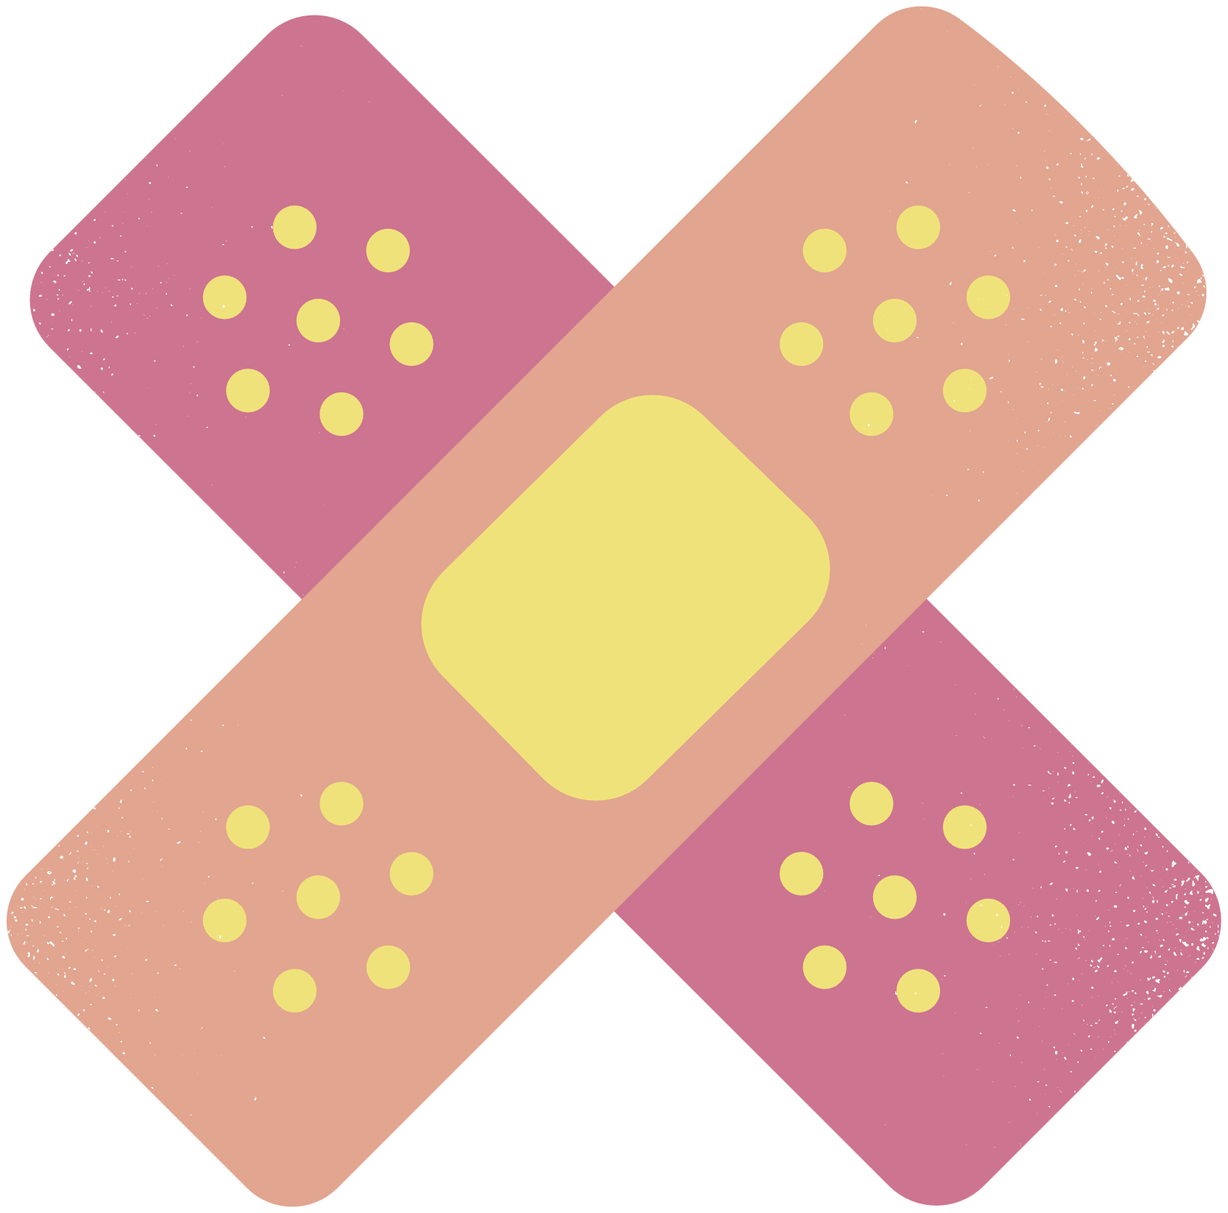
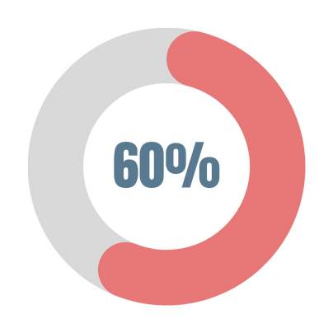
what’s new
Easy to Use:
Show nearby blood banks and pharmacies on a map.
Send alerts for donation opportunities or medicines running low nearby.
01
02
Finding the Best Matches:
Match blood donors to patients based on blood type, urgency, and location.
Help users find pharmacies with the exact medicine they need.
03

Slide 9

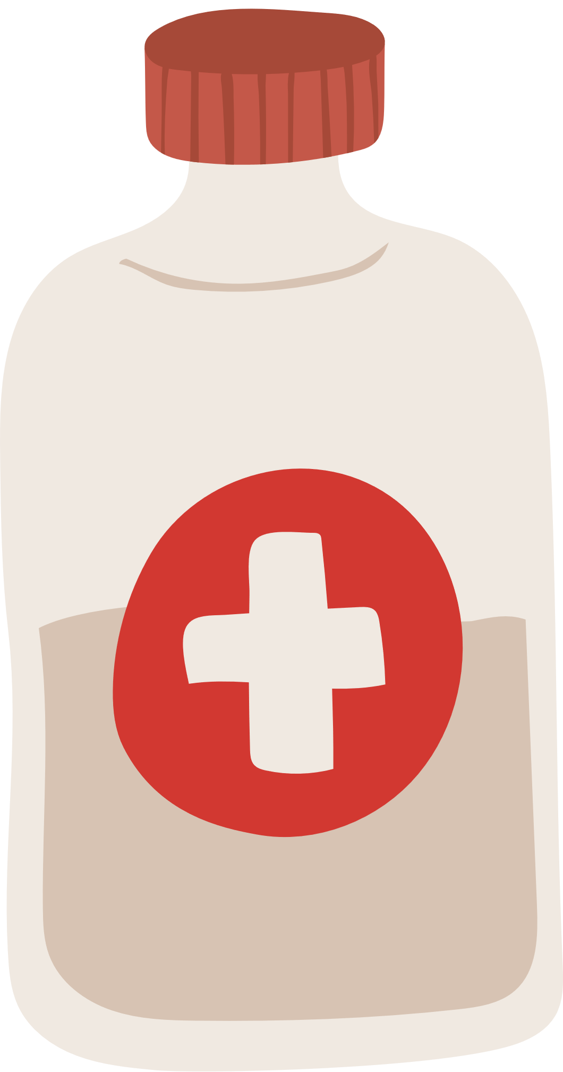
what’s new
Using Feedbacks:
Use feedback to make models and suggestions more accurate.
Update the app regularly to serve users better.
01
02
03
3. Helping People Personally:
Give donors reminders and tips for donating blood.
Recommend medicines based on each person’s medical needs

Slide 10

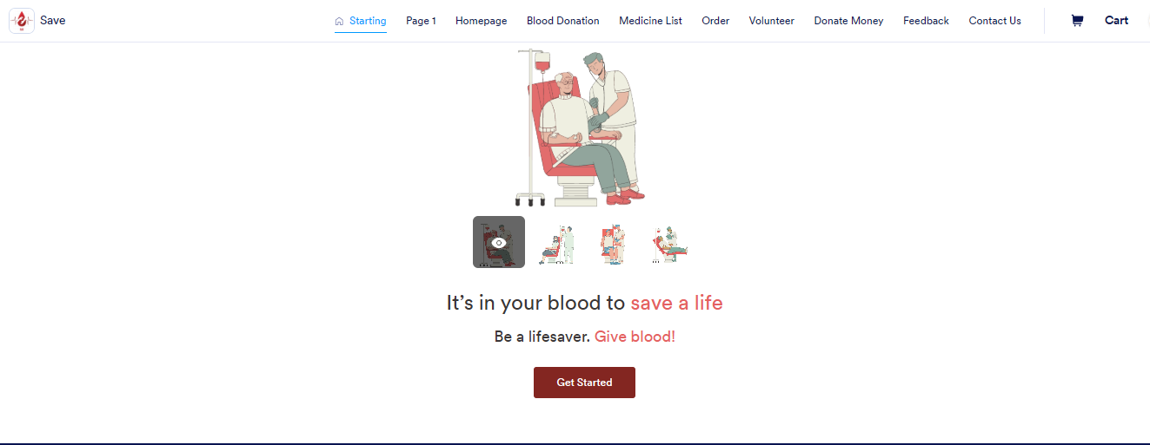
Ease of use of “Save”

Slide 11
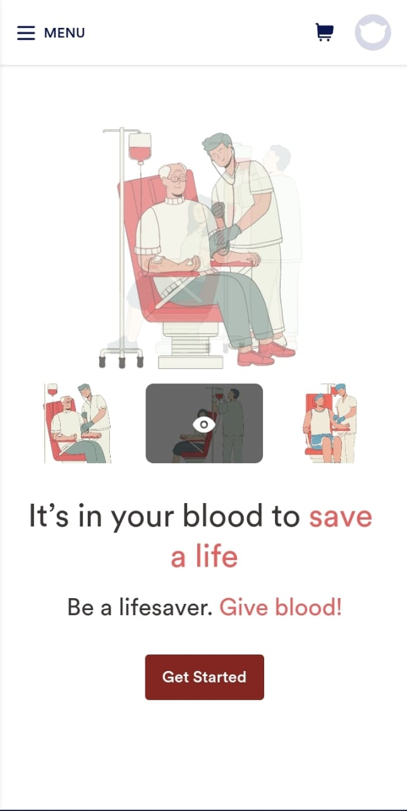
Ease of use of “Save”

Slide 12
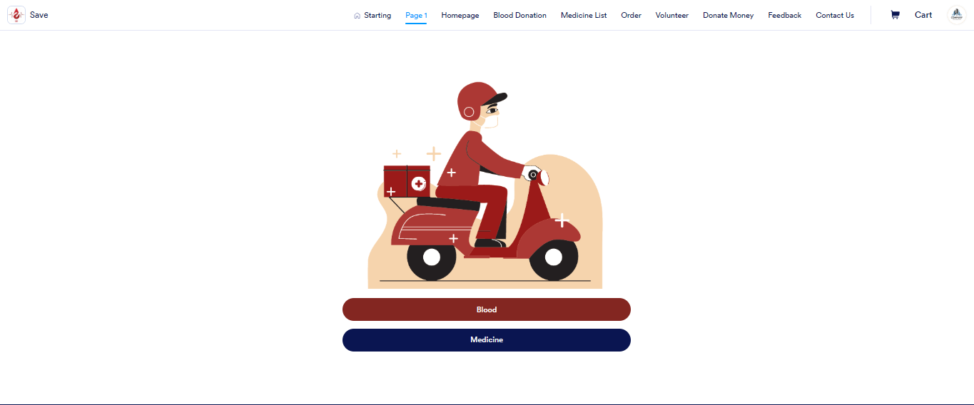
Ease of use of “Save”

Slide 13
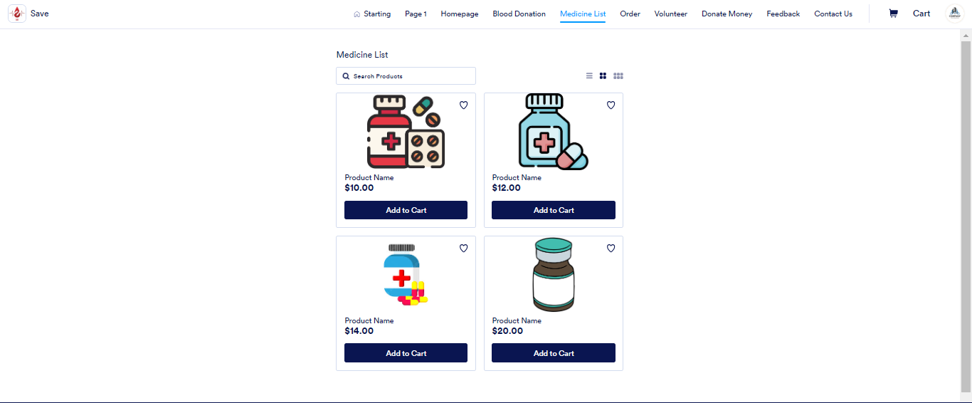
Ease of use of “Save”

Slide 14
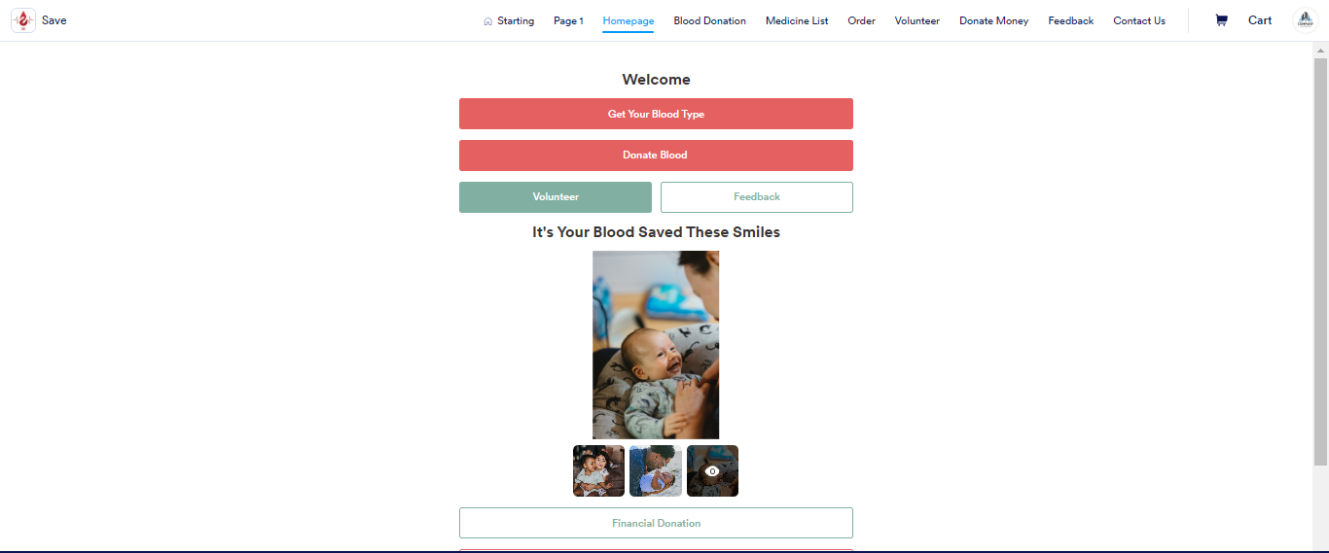
Ease of use of “Save”

Slide 15
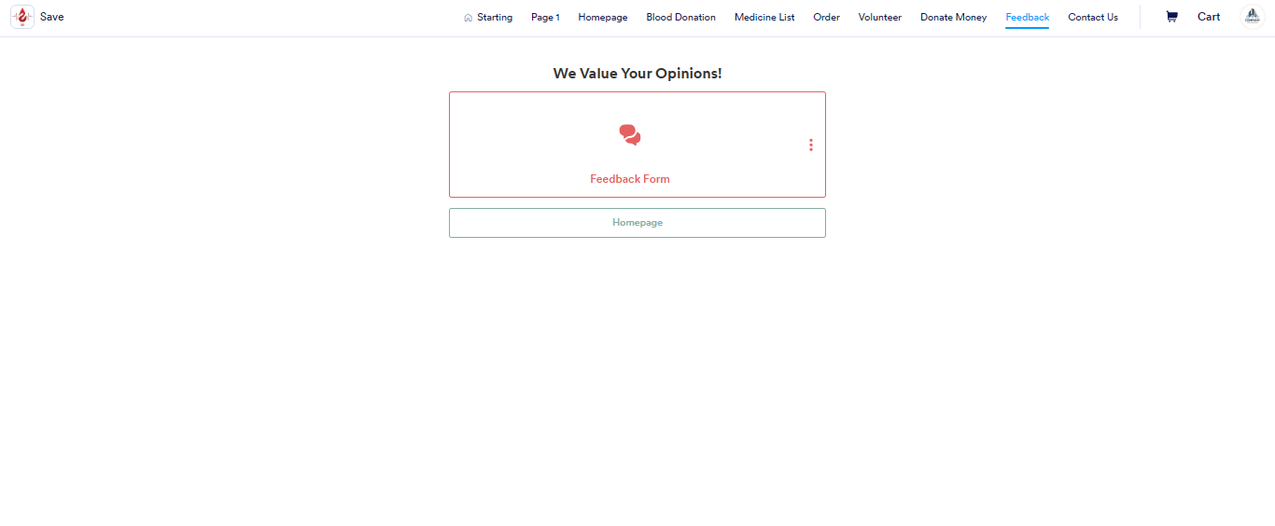
Ease of use of “Save”

Slide 16
THANK YOU

